Slide 1

Role-playing situation
Activity 2
LO#2

Slide 2
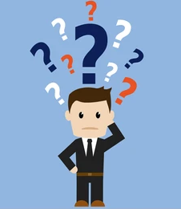
We will make you face situations of everyday life.
Tell us your first reflexes ...

Slide 3
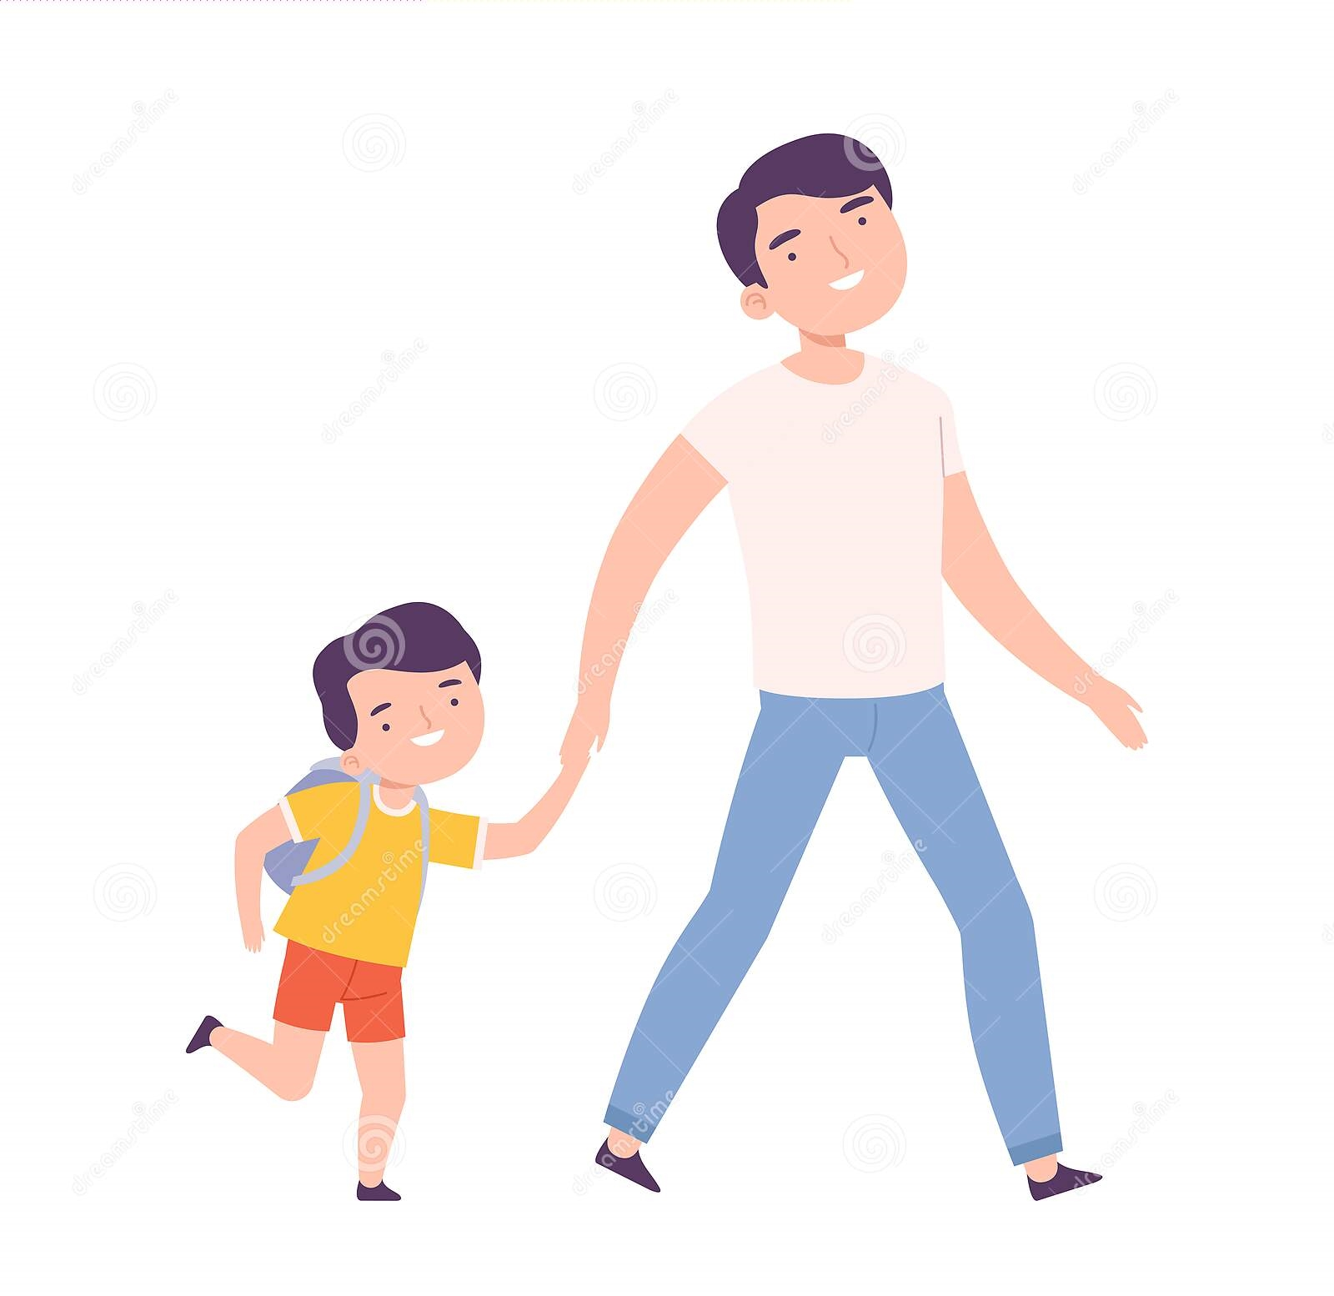
Role-playing situation 1
I arrive at my son's school at 7:45 to drop him off. I see garbage in front of the gate.
What should I do?

Slide 4

Role-playing situation 2
I am at work at the town hall in facetime with my lover. In the background, I see some damage.
Do I have to report it? Knowing that I am not allowed to make unnecessary calls during my work hours?

Slide 5
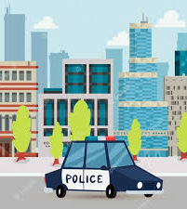
Role-playing situation 3
During my patrol, I am sent to the postal bank which is being robbed. When I get there, I see that Batman has already neutralized the situation.
Should I still report it? Knowing that Batman wasted my time?

Slide 6
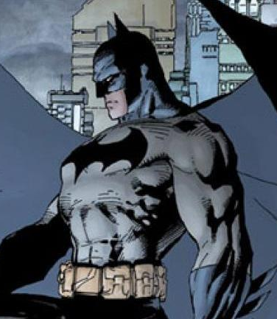
Role-playing situation 4
I'm Batman and I finish fighting a Big Bad in town. (I won of course!)
I see that the confrontation has caused a lot of damage. What should I do?

Slide 7

Role-playing situation 5
I am with my friends and I am hungry. My friends offer to eat a mc do but I have no money.
On my damage report app, I am only one point short of earning a meal ticket.
Do I have to make a false report to earn the point?

Slide 8
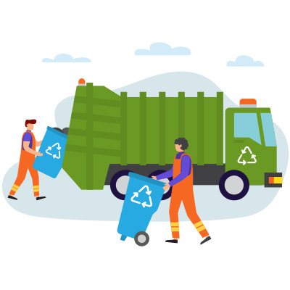
Role-playing situation 6
I am a garbage collector and like every morning, I am making a round to empty the full garbage cans. I get reports of damage that is on the other side of town.
What should I do? Continue my rounds or go immediately to the location of the report?

Slide 9
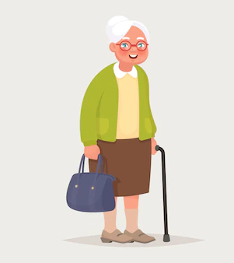
Role-playing situation 7
I am an elderly person, I discover a lot of garbage in front of my house.
I have trouble using the reporting application, what should I do?

Slide 10

Role-playing situation 8
I'm walking around town with my boyfriend.
We decided to leave our phones at home to enjoy fully.
We fall on an incredible scene... of waste everywhere on the ground.
What could we do without our phones?

